Slide 1
Thailand

Slide 2
CONTENT
Basic socio-demographic indicators
HIV prevalence and epidemiological status (1990-2009)
Risk behaviors (2003-2009)
Vulnerability and HIV knowledge (2004-2009)
HIV expenditure (2001-2009)
National Response (2004-2009)
Archives

Slide 3
BASIC SOCIO-DEMOGRAPHIC INDICATORS
Total population (in thousands) | 68,139 (2010)²
Annual population growth rate | 0.5% (2010-2015)²
Population aged 15-49 (thousands) | 37,383 (2008)⁶
Percentage of population in urban areas | 34% (2010)¹
Crude birth rate (births per 1,000 population) | 14.5 (2008)³
Under-5 mortality rate (per 1,000 live births) | 14 (2008)⁴
Human development index (HDI) - Rank/Value | 92/0.654 (2010)⁵
Life expectancy at birth (years) | 69.3 (2010)⁵
Adult literacy rate | 93.5% (2005-2008)⁵
Ratio of girls to boys in primary and secondary education (%) | 103 (2008)³
GDP per capita (PPP, $US) | 7,995 (2009)³
Per capita total health expenditure (Int.$) | 286 (2007)⁴
Sources: 1.UNFPA. (2010). State of World Population 2010, 2. UN Statistics Division. (2010). Social Indicators, 3.Word Bank. World Data Bank: World Development Indicators & Global Development Finance. Retrieved January, 2011, from http://databank.worldbank.org/ddp/home.do?Step=12&id=4&CNO=2, 4. WHO. (2010). World Health Statistics 2010, 5. UNDP. (2010). Human Development Report 2010, and 6. UN Population Division. (2009). World Population Prospects The 2008 Revision.

Slide 4
HIV prevalence and epidemiological status

Slide 5
Estimated number of adults and children living with HIV, new infections and AIDS deaths, 1990-2009
Source: Prepared by www.aidsdatahub.org based on UNAIDS. (2010). Global Report: UNAIDS Report on the Global AIDS Epidemic.

Slide 6
Estimated number of adults (15+) living with HIV vs women (15+) living with HIV, 1990-2009
Source: Prepared by www.aidsdatahub.org based on UNAIDS. (2010). Global Report: UNAIDS Report on the Global AIDS Epidemic.

Slide 7
% distribution of adults (15+) living with HIV by gender, 1990-2009
Source: Prepared by www.aidsdatahub.org based on UNAIDS. (2010). Global Report: UNAIDS Report on the Global AIDS Epidemic.

Slide 8
Estimated adult HIV prevalence vs new HIV infections, 1990-2009
Source: Prepared by www.aidsdatahub.org based on UNAIDS. (2010). Global Report: UNAIDS Report on the Global AIDS Epidemic.

Slide 9
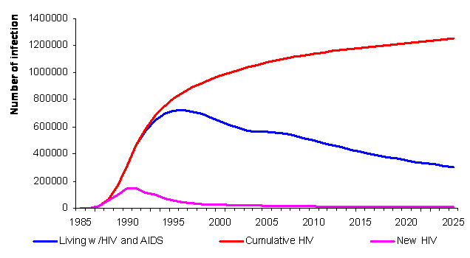
Estimated number of HIV infections, 1985-2025
Source: Brown T and Thailand A2 Team. Preliminary results of HIV/AIDS projection 2005-2025. Presentation at the Integrated Analysis and Advocacy-HIV/AIDS Projection Meeting, Ministry of Public Health. December 9, 2006

Slide 10
Estimated number of people living with HIV, 2001-2007
Source: Prepared by www.aidsdatahub.org based on WHO, & UNAIDS. (2008). Thailand: Epidemiological Country Profile on HIV and AIDS.

Slide 11
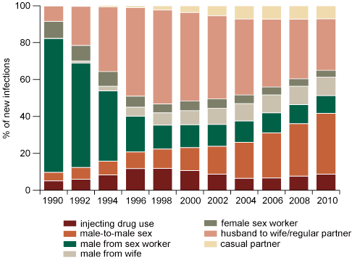
Estimated new HIV infections by mode of transmission, 1990–2010
Source: Asia Epidemic Model, HIV/AIDS projections; Ministry of Public Health, Thailand, 2008 cited in WHO. (2009). HIV/AIDS in the South-East Asia Region 2009.

Slide 12
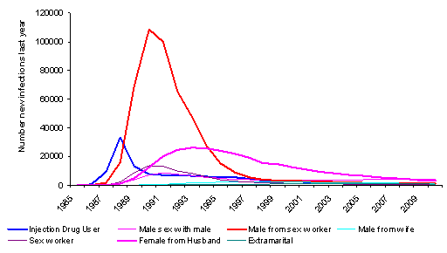
Changing routes of transmission over the course of Thai epidemic, 1985-2009
Year
Source: The Thai Working Group on HIV/AIDS Projection. Projections for HIV/AIDS in Thailand: 2000-2020. Ministry of Public Health, Bangkok. 2001

Slide 13
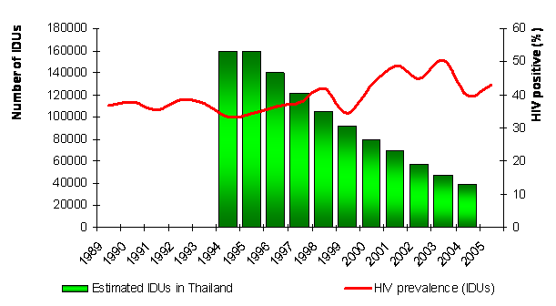
Estimated number of IDUs, 1994-2005 and HIV prevalence among IDUs, 1989-2005
Year
Sources: Bureau of Epidemiology, Department of Disease Control, Ministry of Public Health and Brown T. and Thailand A2 Team. Updating Thai Projections: Inputs and Assumptions. Thai Ministry of Public Health. Presentation on December 9, 2006

Slide 14
Estimated number of HIV + pregnant women, 2008-2010
Source: Prepared by www.aidsdatahub.org based on Thailand country presentation, East Asia and Pacific Regional Office HIV & AIDS Chiefs and Specialists’ Meeting, 17-20 th November 2009, Bangkok

Slide 15
% distribution of reported HIV/AIDS cases, by gender, 1990 and 2008
Source: Prepared by www.aidsdatahub.org based on Asia Epidemic Model, HIV/AIDS projections; Ministry of Public Health, Thailand, 2008 cited in WHO. (2009). HIV/AIDS in the South-East Asia Region 2009.

Slide 16
% distribution of new HIV infections by population group, 2008
Source: Prepared by www.aidsdatahub.org based on Bureau of AIDS, TB and STI, DDC, MOPH cited in WHO. (2009). HIV/AIDS in the South-East Asia Region 2009.

Slide 17
Trends in HIV prevalence among key affected populations, 2003 - 2009
Sources: Prepared by www.aidsdatahub.org based on HIV Sentinel Surveillance (HSS) of BOE, DDC ; Joint Study of Thai MOPH - US-CDC-collaboration (TUC) and BOE cited in1. National AIDS Prevention and Alleviation Committee Thailand. (2008). UNGASS Country Progress Report: Thailand, and 2. National AIDS Prevention and Alleviation Committee Thailand. (2010). UNGASS Country Progress Report: Thailand.

Slide 18
Trends in HIV prevalence among key affected populations, Bangkok, 2001 - 2009
Sources: Prepared by www.aidsdatahub.org based on HIV Sentinel Surveillance (HSS) of BOE, DDC_Thailand 2001 to 2009 and BOE, DDC_HSS 2009 cited in National AIDS Prevention and Alleviation Committee Thailand. (2010). UNGASS Country Progress Report: Thailand.

Slide 19
HIV prevalence among direct FSWs by region, 2009
Source: Prepared by www.aidsdatahub.org based on HIV Sentinel Surveillance (HSS) of BOE, DDC, Thailand cited in National AIDS Prevention and Alleviation Committee Thailand. (2010). UNGASS Country Progress Report: Thailand.

Slide 20
Trends in HIV prevalence among direct and indirect FSWs, 1993 - 2009
Sources: Prepared by www.aidsdatahub.org based on HIV Sentinel Surveillance (HSS) of BOE, DDC, Thailand cited in National AIDS Prevention and Alleviation Committee Thailand. (2010). UNGASS Country Progress Report: Thailand.

Slide 21
Trends in HIV prevalence among direct FSWs, selected provinces, 2001 - 2009
Source: Prepared by www.aidsdatahub.org based on HIV Sentinel Surveillance (HSS) of BOE, DDC, Thailand

Slide 22
Trends in HIV prevalence among indirect FSW, selected provinces, 2001 - 2009
Source: Prepared by www.aidsdatahub.org based on HIV Sentinel Surveillance (HSS) of BOE, DDC, Thailand

Slide 23
HIV prevalence among FSWs, selected provinces, 2009
Source: Prepared by www.aidsdatahub.org based on HIV Sentinel Surveillance (HSS) of BOE, DDC, Thailand

Slide 24
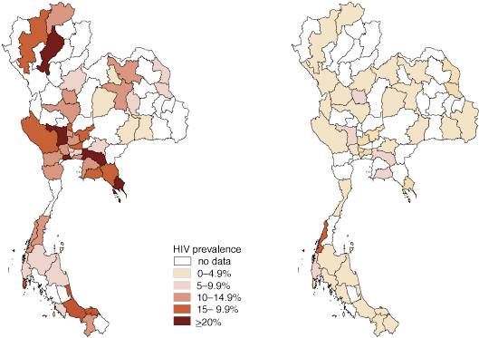
HIV prevalence among female sex workers, by district, 1998 and 2008
1998
2008
Source: Sentinel surveillance data reported by Ministry of Public Health, Thailand_cited in WHO. (2009). HIV/AIDS in the South-East Asia Region 2009.

Slide 25
Trend of HIV prevalence among IDUs, Bangkok, 1995 - 2009
Source: Prepared by www.aidsdatahub.org based on Thailand_HIV Sentinel Surveillance (HSS) of BOE, DDC, 1995 - 2009

Slide 26
Trends in HIV prevalence among IDUs, selected sentinel sites, 2001 - 2009
Sample size, 2009 : Bkk= 126, Yala = 20, Lampang= 2, Samut Prakan =21
Source: Prepared by www.aidsdatahub.org based on Thailand_HIV Sentinel Surveillance (HSS) of BOE, DDC, 2001 - 2009

Slide 27
HIV prevalence among IDUs, selected sentinel sites, 2009
Sample size : Bkk= 126, Yala = 20, Lampang= 2, Samut Prakan =21
Source: Prepared by www.aidsdatahub.org based on HIV Sentinel Surveillance (HSS) of BOE, DDC, Thailand

Slide 28
Trends in HIV prevalence among MSM, selected sentinel sites, 2003 - 2009
Source: Prepared by www.aidsdatahub.org based on Thailand_HIV Sentinel Surveillance (HSS) of BOE, DDC and TUC, 2003 - 2009 cited in National AIDS Prevention and Alleviation Committee Thailand. (2010). UNGASS Country Progress Report: Thailand.

Slide 29
Trend of HIV prevalence among pregnant women, 1991 - 2009
Source: Prepared by www.aidsdatahub.org based on Thailand_HIV Sentinel Surveillance (HSS) of BOE, DDC, 1991 - 2009

Slide 30
HIV prevalence among pregnant women by region, 2009
Source: HIV Sentinel Surveillance (HSS) of BOE, DDC, Thailand, cited in National AIDS Prevention and Alleviation Committee Thailand. (2010). UNGASS Country Progress Report: Thailand.

Slide 31
HIV prevalence among pregnant women, selected sentinel sites, 2009
Source: HIV Sentinel Surveillance (HSS) of BOE, DDC, Thailand, 2009

Slide 32
Trends in HIV prevalence among pregnant women, selected sentinel sites, 2001 - 2009
Source: Thailand_HIV Sentinel Surveillance (HSS) of BOE, DDC, 2001 - 2009

Slide 33
Trends in HIV prevalence among young people (15 -24) and pregnant women, 2003 - 2009
Source: Prepared by www.aidsdatahub.org based on Thailand, HIV Sentinel Surveillance (HSS) of BOE, DDC, 2003 – 2009 cited in National AIDS Prevention and Alleviation Committee Thailand. (2010). UNGASS Country Progress Report: Thailand.

Slide 34
Archives

Slide 35
HIV prevalence and epidemiological status

Slide 36
HIV prevalence among IDUs,1990-2004
(%)
60
60
52
50.3
53.7
46.9
47.4
52.0
50
46
47.8
43.9
42.2
45.0
44
44
41.4
41.7
42
42
41.0
39
42
40
40.9
(Number of sites)
35.8
34.6
39
37.8
39.6
40
36.7
34
37.5
36
32.2
29.7
31.5
31.6
33.1
38.0
30
31.4
31.4
29
30
28
27
23.1
18
20
Major urban area
N-site major urban area
Outside major urban area
N-site outside major urban area
8
10
1
1
1
1
1
1
1
1
1
1
1
1
1
1
1
0
0
1990
1991
1992
1993
1994
1995
1996
1997
1998
1999
2000
2001
2002
2003
2004
Year
Source: Prepared by www.aidsdatahub.org based on European Union, WHO, UNICEF, et al. (2006). Thailand: Epidemiological Fact Sheet on HIV/AIDS and Sexually Transmitted Infections- 2006 Update

Slide 37
HIV prevalence among MSM, 1990-2003
(%)
20
16
15.2
17.3
14
12
11.1
(Number of sites)
10
10
Major urban area
8
N-site major urban area
Outside major urban area
6
N-site outside major urban area
5
4.4
4
3
3
2
1
1
1
0
0
1990
1991
1992
1993
1994
1995
1996
1997
1998
1999
2000
2001
2002
2003
2004
Year
Source: European Union, WHO, UNICEF, et al. (2006). Thailand: Epidemiological Fact Sheet on HIV/AIDS and Sexually Transmitted Infections- 2006 Update

Slide 38
HIV prevalence among sex workers, 1990-2004
(%)
(Number of sites)
Year
Source: Prepared by www.aidsdatahub.org based on European Union, WHO, UNICEF, et al. (2006). Thailand: Epidemiological Fact Sheet on HIV/AIDS and Sexually Transmitted Infections- 2006 Update

Slide 39
HIV prevalence among STI patients, 1990-2004
(%)
14
Outside major urban area
N-site outside major urban area
80
Major urban area
N-site Major urban area
12
67
70
65
11.6
62
63
64
(Number of sites)
10
60
9.9
57
55
9.6
8.7
8.8
49
49
49
50
8
8.2
45
44
42
6.9
6.8
7
40
6
6.1
6.4
5.6
5.1
32
32
30
4
20
2.6
8.9
8.7
8.3
9.1
2.5
2
5
5.7
7.8
6.7
7.7
6.3
5.9
4.9
10
1
1
1
1
1
1
1
1
1
1
1
1
1
4.2
1
4
1
2.6
0
0
1990
1991
1992
1993
1994
1995
1996
1997
1998
1999
2000
2001
2002
2003
2004
Year
Source: Prepared by www.aidsdatahub.org based on European Union, WHO, UNICEF, et al. (2006). Thailand: Epidemiological Fact Sheet on HIV/AIDS and Sexually Transmitted Infections- 2006 Update

Slide 40
HIV prevalence among pregnant women, 1990-2004
(%)
2.5
75
75
75
75
75
75
75
75
75
80
70
70
72
73
69
2.3
2.1
70
2
1.9
1.9
60
1.7
(Number of sites)
1.5
1.6
1.6
50
1.2
1.3
1.2
40
1
1
1
1
1
1
1
1
1
1
1
1
1.1
1.1
1
1
1
30
22
0.6
Major urban area
N-site major urban area
20
0.5
Outside major urban area
N-site outside major urban area
10
0.2
0
0.7
1
1.4
1.8
2.3
1.8
1.7
1.5
1.8
1.5
1.4
1.4
1.2
1
0
0
1990
1991
1992
1993
1994
1995
1996
1997
1998
1999
2000
2001
2002
2003
2004
Year
Source: Prepared by www.aidsdatahub.org based on European Union, WHO, UNICEF, et al. (2006). Thailand: Epidemiological Fact Sheet on HIV/AIDS and Sexually Transmitted Infections- 2006 Update

Slide 41
HIV prevalence among young people (15-24), 2002-2007
(%)
1
0.95
0.64
0.5
0.45
0
2002-2003
2004-2005
2006-2007
Source: National AIDS Prevention and Alleviation Committee Thailand. (2008). UNGASS Country Progress Report: Thailand

Slide 42
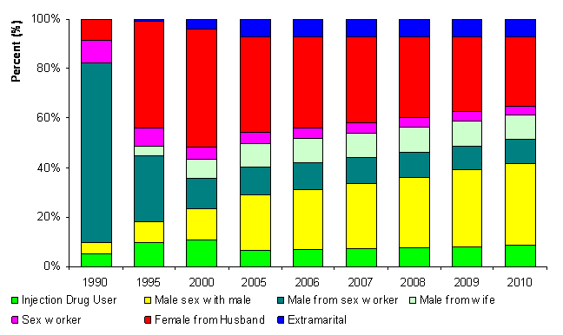
HIV transmission pattern over time, 1990-2010
Source: Brown T and Thailand A2 Team. Preliminary results of HIV/AIDS projection 2005-2025. Presentation at the Integrated Analysis and Advocacy-HIV/AIDS Projection Meeting, Ministry of Public Health. December 9, 2006

Slide 43
THANK YOU
slides compiled by www.aidsdatahub.org
Data shown in this slide set are comprehensive to the extent they are available from country reports. Please inform us if you know of sources where more recent data can be used.
Please acknowledge www.aidsdatahub.org if slides are lifted directly from this site

